Slide 1
Lecture 5
Unisole empower

Slide 2
Objectives of the Lecture
Understands the basic of Reinforcemnt learning.
Understanding of RLHF + PPO

Slide 3
Introduction
Reinforcement learning from human feedback (RLHF) is a fine-tuning mechanism that uses human annotation—also called human feedback—to help the model adapt to human values and preferences.
RLHF is most commonly applied after other forms of fine-tuning, including instruction fine-tuning.
Human Alignment : Helpful, Honest and Harmless.

Slide 4
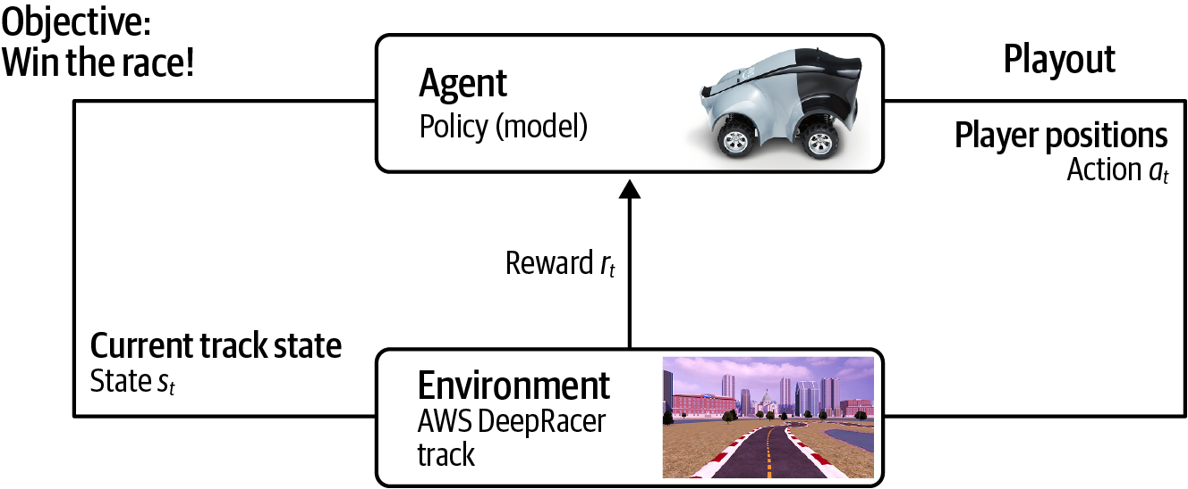
Example of Reinforcement Learning

Slide 5
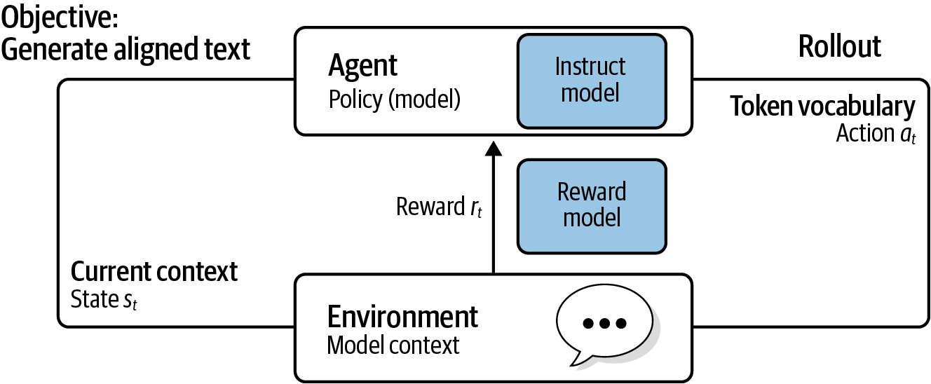
RL in context of GenAI model

Slide 6
Key points from past example
The goal of reinforcement learning is for the agent to learn the optimal policy, or model, for choosing the actions for a given environment that maximizes the reward.
In context of GenAI, The model is the agent. The policy consists of the model weights. The RL algorithm will update the model weights to choose a better action, or generate a better next-token, given the environment, state, and objective. The objective is for the model to generate completions that are better aligned with human preferences such as helpfulness, honesty, and harmlessness (HHH).

Slide 7
Train a Custom Reward Model
A reward model is typically a classifier that predicts one of two classes— positive or negative. These are often called binary classifiers and are often based on smaller language models like BERT.
Many language-aware binary classifiers already exist to classify sentiment or detect toxic language. If these are not suitable for our use case, then we can train our own reward model.

Slide 8
Collect Training Dataset with Human-in-the-Loop
The first step to training a custom reward model is to collect data from humans on what is helpful, honest, and harmless. This is called collecting human feedback from human annotators, or labelers. This step typically involves a managed service like SageMaker Ground Truth.

